Slide 1
Lectures 4a,4b: Exponential & Logarithmic Functions
(4.1) Exponential & Logarithmic Functions in Biology
(4.2) Exponential & Logarithmic Functions: Review
(4.3) Allometry
(4.4) Rescaling data: Log-Log & Semi-Log Graphs

Slide 2
1. (4.1) Exponential & Logarithmic Functions in Biology
Recall from last time that we were able to come up with a “best” linear fit for bivariate data that seem to be linearly related
In many cases, however, if you were to plot data points obtained from biological measurements you would find that the data are not linearly related
As an example, consider population growth:
Imagine algae growing in a Petri dish, starting from a single cell
Through time the cell will split (or else die), then each new cell will split again, etc.
The total number of cells does not increase linearly (in an additive manner) through time but multiplicatively (by doubling)
If you were to plot the number of cells through time, it would not increase linearly

Slide 3
The Key Idea
1. (4.1) Exponential & Logarithmic Functions in Biology
Exponentials are used to describe something that increases (or decreases) in a multiplicative manner
Logarithms are a way to rescale something that is increasing (or decreasing) in a multiplicative manner so as to measure its increase in a new way that does increase (or decrease) linearly
This arises from the fact that the logarithm of a product is the sum of the logarithms of the components of the product:
log(ab) = log(a) + log(b)
ln(ab) = ln(a) + ln(b)

Slide 4
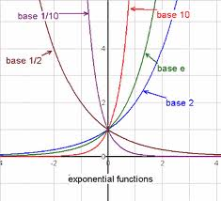
Exponential Functions
2. (4.2) Exponential & Logarithmic Functions: Review
Definition: An exponential function is a function of the form
where a > 0 is a fixed real number called the base of the exponent
Note: This is different from the power function where the base is the variable and the exponent a is a fixed constant

Slide 5
Laws of Exponents
2. (4.2) Exponential & Logarithmic Functions: Review

Slide 6
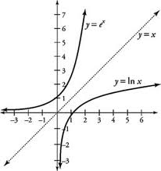
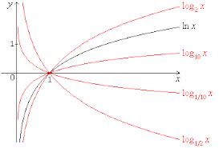
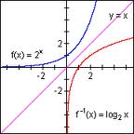
Logarithmic Functions
2. (4.2) Exponential & Logarithmic Functions: Review
Definition: A logarithmic function is a function of the form
where a > 0 is a fixed real number called the base of the logarithm
The logarithmic function is the inverse of the exponential function:
and

Slide 7
Laws of Logarithms
2. (4.2) Exponential & Logarithmic Functions: Review

Slide 8
Example 4.1
2. (4.2) Exponential & Logarithmic Functions: Review
Solve:
Solution:

Slide 9
Example 4.2
2. (4.2) Exponential & Logarithmic Functions: Review
If and , then find .
Solution:

Slide 10
Example 4.3
2. (4.2) Exponential & Logarithmic Functions: Review
Solve:
Solution:

Slide 11
Half-Life & Doubling Time
2. (4.2) Exponential & Logarithmic Functions: Review
Logarithms and exponentials are frequently used to calculate the half-life of radioactive substances or the doubling time of populations.
The half-life of a radioactive substance is how long it takes for N amount of that substance to decay to 1/2 N amount
The doubling time of a population is how long it takes N individuals in that population to reproduce and become 2N individuals

Slide 12
Example 4.4
2. (4.2) Exponential & Logarithmic Functions: Review
It has been shown that the amount of drug in a person’s body decays exponentially
Let C(t) denote the concentration of the drug in the bloodstream at time t (in days), and let C₀ be the initial amount of drug in the bloodstream
Then we can write C(t) = C₀e^{−kt} where k > 0 is known as a decay constant. The larger the value of k, the more quickly the drug decays in the bloodstream
(a) If the drug has a half-life of 10 days, what is the value of k?
(b) What percent of the administered amount of drug remains in the bloodstream after 4 hours?

Slide 13
Example 4.4
2. (4.2) Exponential & Logarithmic Functions: Review
(a) A half-life of 10 days means that when t = 10 we should have 1/2 of the initial amount of drug, C₀:
From the given relation we have:
Hence:

Slide 14
Example 4.4
2. (4.2) Exponential & Logarithmic Functions: Review
(b) Using the results from (a), our equation for the decay of the drug in the bloodstream is C(t) = C₀e^{−0.069t}
Recall that t is measured in days, thus if we want to know how much is left after 4 hours, we need to convert this to units of days: 4 hours × 1 day/24 hours = 1/6 days. Thus, we want to know how much of C₀ is left after 1/6 days:
Thus, there is approximately 98.9% of the administered dose left after 4 hours.

Slide 15
Example 4.5
2. (4.2) Exponential & Logarithmic Functions: Review
Biologists studying salmon have found that the oxygen consumption of yearling salmon (in appropriate units) increases exponentially with the speed of swimming
Specifically, f(x) = 100e^{0.6x} where x is the speed in feet per second, and f gives the oxygen consumption
Find each of the following:
(a) The oxygen consumption when the ﬁsh are not moving
(b) The oxygen consumption at a speed of 2 ft/s
(c) If a salmon is swimming at 2 ft/s, how much faster does it need to swim to double its oxygen consumption?

Slide 16
Example 4.5
2. (4.2) Exponential & Logarithmic Functions: Review
Find the oxygen consumption when the ﬁsh are not moving.
Solution:
When the ﬁsh are not moving, their speed is 0 ft/s.
Thus, when x=0, f(0) = 100e^{0.6×0}
= 100e⁰
= 100 × 1
= 100
Thus, when the ﬁsh are not moving, their oxygen consumption is 100 units.

Slide 17
Example 4.5
2. (4.2) Exponential & Logarithmic Functions: Review
(b) Find the oxygen consumption at a speed of 2 ft/s.
Solution:
Here x=2 and f(2) = 100e^{0.6×2}
= 100e^{1.2}
≈ 332
Thus, at a speed of 2 ft/s, oxygen consumption is 332 units.

Slide 18
Example 4.5
2. (4.2) Exponential & Logarithmic Functions: Review
(c) If a salmon is swimming at 2 ft/s, how much faster does it need to swim to double its oxygen consumption?
Solution:
We want to solve for x when oxygen consumption is 2 × f(2) = 2 × 332 = 664 units.
664 = 100e^{0.6x}
6.64 = e^{0.6x}
ln 6.64 = ln e^{0.6x}
ln 6.64 = 0.6x
x = ln 6.64 / 0.6 ≈ 3.16 ft/s
Notice, 3.16 ft/s is 3.16 − 2 = 1.16 ft/s faster than 2 ft/s. Thus, to get double the oxygen consumption as when swimming 2 ft/s, the salmon would have to swim 1.16 ft/s faster.

Slide 19
Introduction
3. (4.3) Allometry
Definition: two variables x and y are said to be allometrically related if where a and b are real constants
Note: This is different from an exponential relationship where the variable is in the exponent: It is important that you know the difference, especially in what follows
Some typical biological relationships that are allometric:
Length vs. Volume
Surface area vs. Volume
Body weight vs. brain weight
Body weight vs. blood volume

Slide 20
Example 4.8 (Elephants)
3. (4.3) Allometry
It has been determined that for any elephant, surface area of the body can be estimated as an allometric function of trunk length:
For African elephants the allometric exponent is 0.74:
If a particular elephant has a surface area of 200 ft² and a trunk length of 6 ft, what is the expected surface area of an elephant with a trunk length of 7 ft?

Slide 21
Example 4.8 (Elephants)
3. (4.3) Allometry
We are given:
SA is allometrically related to TL:
The allometric exponent:
A data point:
We need to use the given data point to solve for yet unknown constant, a, and then use the model to make the requested prediction.
Hence the equation:
And the prediction
expected body surface area for a trunk 7 ft long is 223.9 ft²

Slide 22
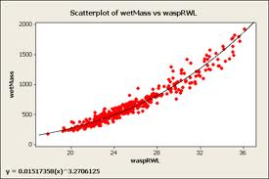
Overview
4. (4.4) Rescaling data: Log-Log & Semi-Log Graphs
Mass Vs. Right Wing Length
Non-Linear Model for Wasps
As pointed out above, data often appear to have a strong relationship, but that relationship is not linear
We would like to apply the same analysis as before, but we would need to develop a new method to get the best fit curve
In some situations, however, a rescaling of the data could transform it in such a way that the new relationship is linear

Slide 23
Rewriting Equations
4. (4.4) Rescaling data: Log-Log & Semi-Log Graphs
To see why this is the case, we begin- not with data- but with the types of curves we use to model the data
We start with an exponential equation:
Let’s compare the structure of this equation with the equation of a line

Slide 24
Rewriting Equations
4. (4.4) Rescaling data: Log-Log & Semi-Log Graphs
The new equation is a linear equation.

Slide 25
Rewriting Equations
4. (4.4) Rescaling data: Log-Log & Semi-Log Graphs
Now consider an allometric equation:
Again, we obtain a linear equation.
We need to take a closer look at these transformations.

Slide 26
Rescaling Data
4. (4.4) Rescaling data: Log-Log & Semi-Log Graphs
Exponential Allometric
What we see is that if we have data that are exponentially related, and we rescale the y coordinates of the data by taking their logarithm (x,y) ➔ (x, lny), then the scatter plot of the rescaled data will be linear
If we have data that are allometrically related, and we rescale the x and y coordinates of the data by taking their logarithm (x,y) ➔ (lnx, lny), then the scatter plot of the rescaled data will be linear

Slide 27
Example 4.9 (Algae Growth)
4. (4.4) Rescaling data: Log-Log & Semi-Log Graphs
Imagine algae growing in a Petri dish, starting from a single cell. After some time the cell will split (or else die). Then, each of the two cells will split, and so on. Thus, the number of cells in the Petri dish does not increase linearly (i.e. in an additive manner), but multiplicatively (by doubling each time).
Suppose the doubling time is 1 day. Thus if we start oﬀ with one cell, after 1 day we will have 2 cells, after 2 days 4 cells, after 3 days 8 cells, etc.
Let us see what happens when we rescale the y-axis data:

Slide 28
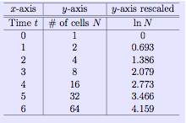
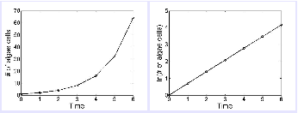
Example 4.9 (Algae Growth)
4. (4.4) Rescaling data: Log-Log & Semi-Log Graphs

Slide 29
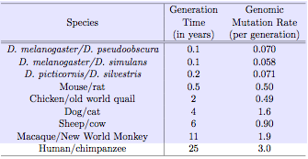
Example 4.11 (Mutation Rates)
4. (4.4) Rescaling data: Log-Log & Semi-Log Graphs
Researchers studying the relationship between the generation time of a species and the mutation rate for genes that cause deleterious eﬀects gathered the following data:

Slide 30
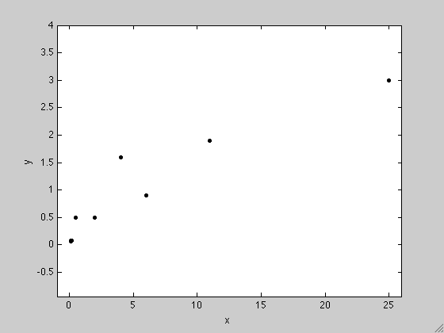
Example 4.11 (Mutation Rates)
4. (4.4) Rescaling data: Log-Log & Semi-Log Graphs
A scatterplot of the data:

Slide 31
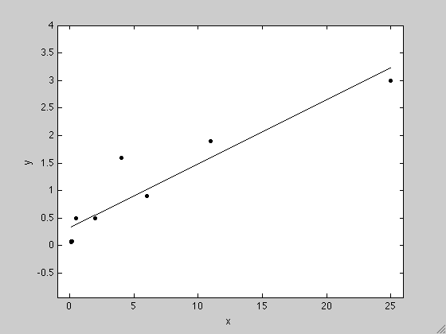
Example 4.11 (Mutation Rates)
4. (4.4) Rescaling data: Log-Log & Semi-Log Graphs
A scatterplot of the data with LSR:

Slide 32
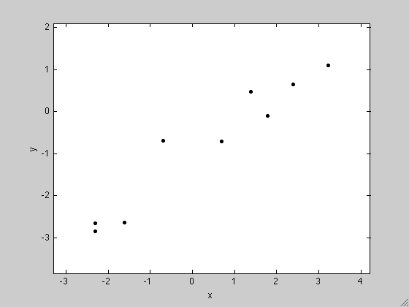
Example 4.11 (Mutation Rates)
4. (4.4) Rescaling data: Log-Log & Semi-Log Graphs
Is this a good fit?
The MATLAB output:
Eqn for LSR: y = 0.116079 x + 0.323640
rho = 0.934107
The regression line accounts for 87.26% of the variance in the data.
Suppose we rescale the data:

Slide 33
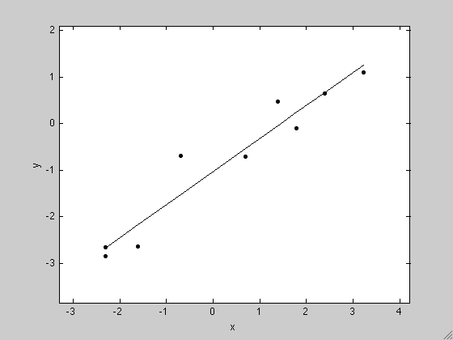
Example 4.11 (Mutation Rates)
4. (4.4) Rescaling data: Log-Log & Semi-Log Graphs
A scatterplot of the data with LSR:

Slide 34
Example 4.11 (Mutation Rates)
4. (4.4) Rescaling data: Log-Log & Semi-Log Graphs
Is this a good fit?
The MATLAB output:
Eqn for LSR: ln y = 0.709705 ln x + -1.031581
rho = 0.962501
The regression line accounts for 92.64% of the variance in the data
Which model should we choose?

Slide 35
Example 4.11 (Mutation Rates)
4. (4.4) Rescaling data: Log-Log & Semi-Log Graphs
If we choose the allometric model, we need to recover x and y:
Now we can use the model to predict. Suppose we know a certain species has a generation time of 10 years, we could interpolate the genomic mutation rate of this species:
mutations per generation

Slide 36
Homework
Chapter 4: 4.1 b,d,e,g,h 4.2, 4.3, 4.5, 4.7, 4.8, 4.10, 4.11 4.12
some answers:
4.5 a. y = 100 (1.26)^x b. 5.9 months
4.7 a. L= (10)^(-2/3) R^(2/3) b. plant A has 2^(2/3) more leaf biomass than plant B

